Slide 1
NeXT hikes IT Solutions
Project 1: GUI-based calculator using Tkinter
By Pandurang Choudhari

Slide 2
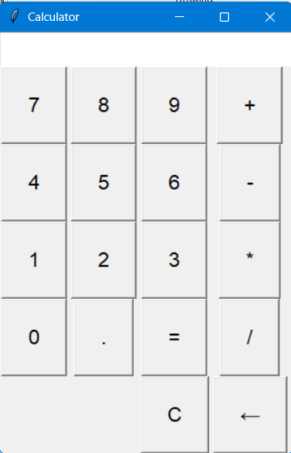
Project overview:
Calculator with basic functionalities such as addition (+), subtraction (-), multiplication (*), division (/), cancel (C) and backspace (←).

Slide 3
Steps followed
“Tkinter" module is imported.
Functions "button_click(), "clear" are defined for button clicks.
The main Tkinter window root is created and its title is set.
An input field is created using 'tk.Entry' for displaying and entering expressions.
Buttons for digits (0-9) and operators (+, -, *, /) are created using tk.Button and the button_click function is linked to each button to update the input field.
Clear (C), Equal to (=) buttons are created and a Backspace (←) button is added. This backspace button helps to delete the character from the input field, one character at a time.
The Tkinter main loop with root.mainloop() should be now started to get the final calculator output.

Slide 4
Challenges and workaround
The main and only challenge while creating this basic calculator was the ‘syntax error’. It occurred due to grammatical errors and some extra spaces.
Error was then identified and rectified as per the sequence number of coding displayed in syntax error.

Slide 5
References
Digicrome study material
Geeks forGeeks

Slide 6


